Slide 1
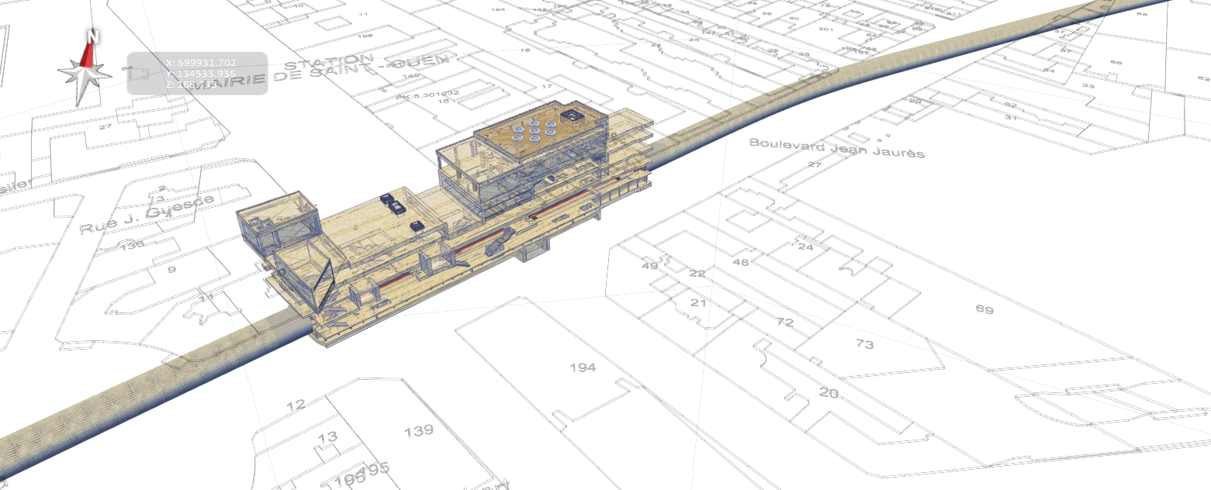
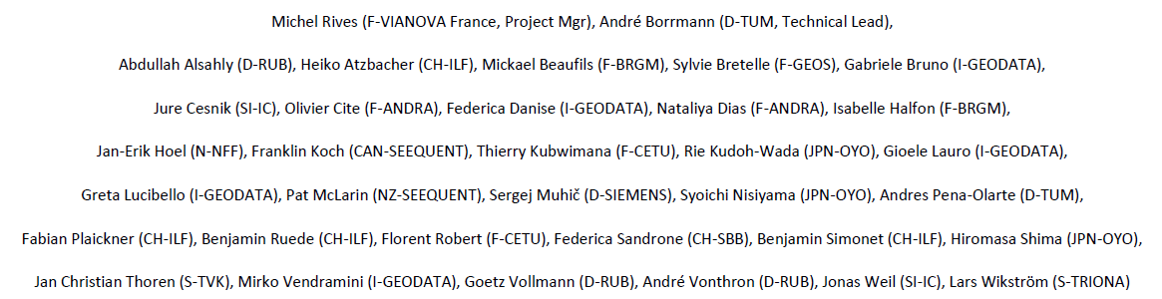
IDBE Geotech workshop 2021 IfcTunnel Update June 21st, 2021
Jonas Weil, bSI IfcTunnel Project Team, iC group
Sub-group Geology & Geotechnics

Slide 2





IfcTunnel – Geology & Geotechnics
Overview current activities and status:
Requirement analysis
Use case descriptions (as published in WP2)
Draft-taxonomy for conceptual model, including
object type hierarchy
system and spatial breakdown structure
Concepts to describe different kinds of uncertainty
Geometrical representations: Requirement of voxel models
Next steps:
Definition of properties
Relation/links between model elements with respect to the use cases
Input
Etc.

Slide 3
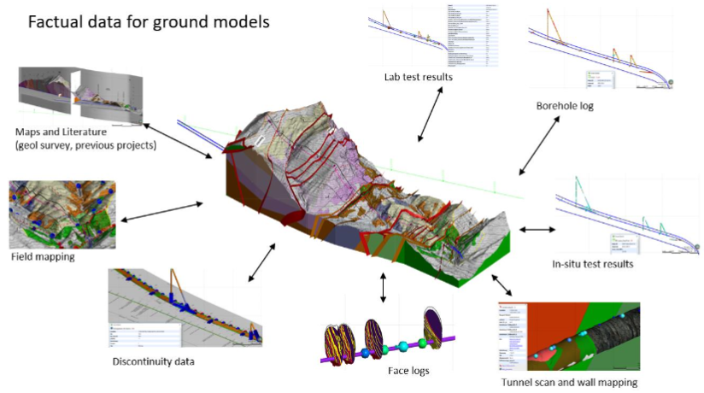
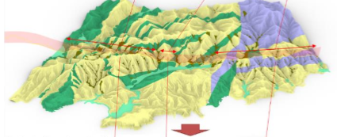
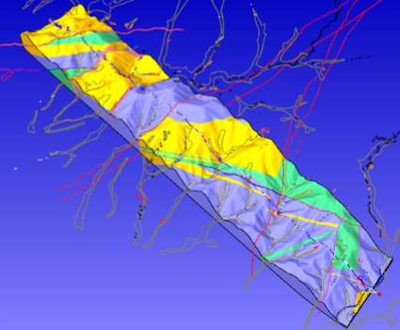
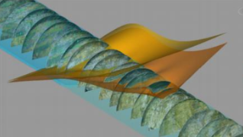
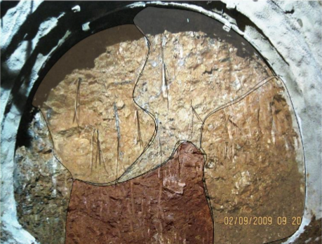
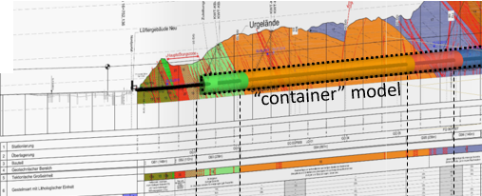
IfcTunnel – Geology & Geotechnics
Use Cases (ground model related)
1b Geological factual data
2a Geological and geotechnical modelling for planning
2b Geotechnical modelling for design
2c geotechnical modelling for construction and maintenance
12b Geotechnical Model for tender, time and cost estimation
15b geological documentation

Slide 4
IfcTunnel – Geology & Geotechnics
Focal points: exchanged geological/geotechnical information and models
A: Factual Data (inputs, measurements and observations, before and during construction)
B: Interpreted models (geological, but for tunneling mainly geotechnical models)
C: Design solutions, applications and risk assessment based on these interpreted models

Slide 5
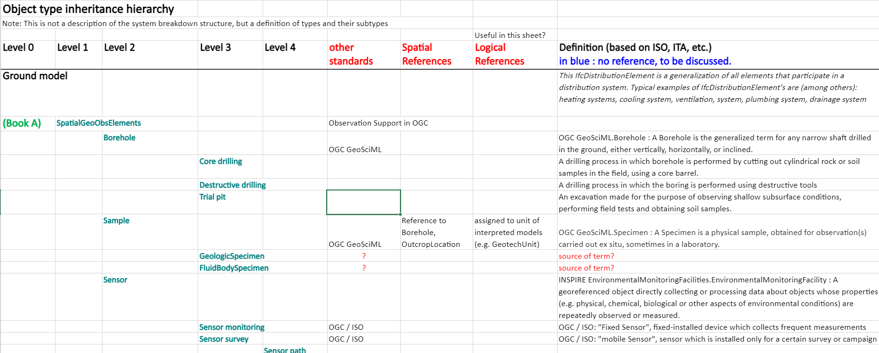
IfcTunnel – Geology & Geotechnics
Semantics and Taxonomy –
current status
Observations and Measurements
Discussion of possible system breakdown and object classification, as a base for implementation by the Tech Team
Domain-specific collection of typical data sets
Classification in types of observations: orientation at existing concepts
Objects with geometrical representation vs. semantic elements / c
Object type inheritance hierarchy

Slide 6
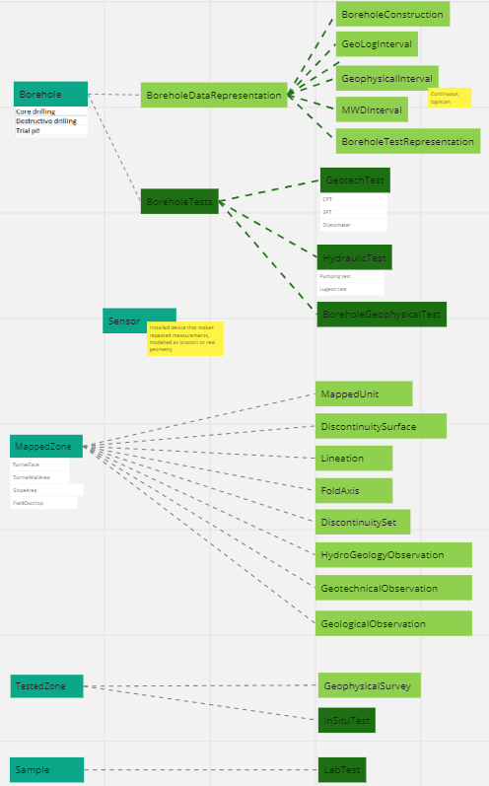
IfcTunnel – Geology & Geotechnics
Semantics and Taxonomy –
current status
Observations and Measurements
Discussion of possible system breakdown and object classification, as a base for implementation by the Tech Team
Domain-specific collection of typical data sets
Classification in types of observations: orientation at existing concepts
Objects with geometrical representation vs. semantic elements / c
Graphical visualization on
Miro board

Slide 7
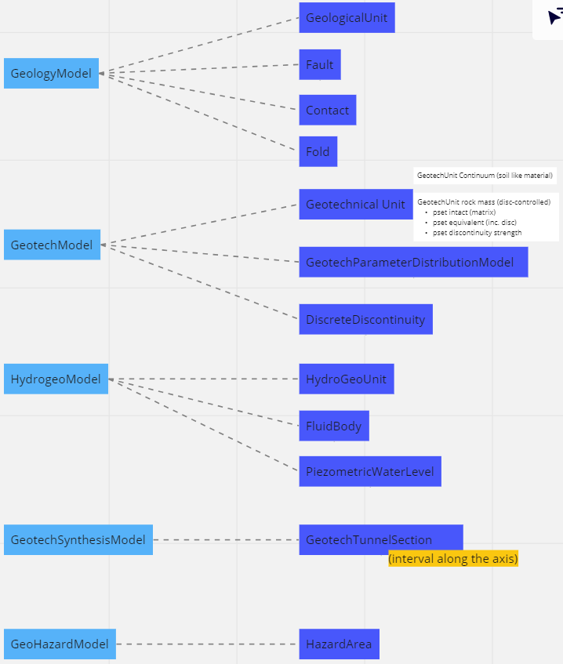
IfcTunnel – Geology & Geotechnics
Semantics and Taxonomy – current status
Interpreted Models
Discussion of possible system breakdown and object classification, as a base for implementation by the Tech Team
Several models, representing specific classifications of the ground conditions as well as uncertainty and methodological info
“GeotechSynthesisModel” as a link to building structure: e.g. representation of Geotechnical Baseline Report and Longitudinal Section

Slide 8
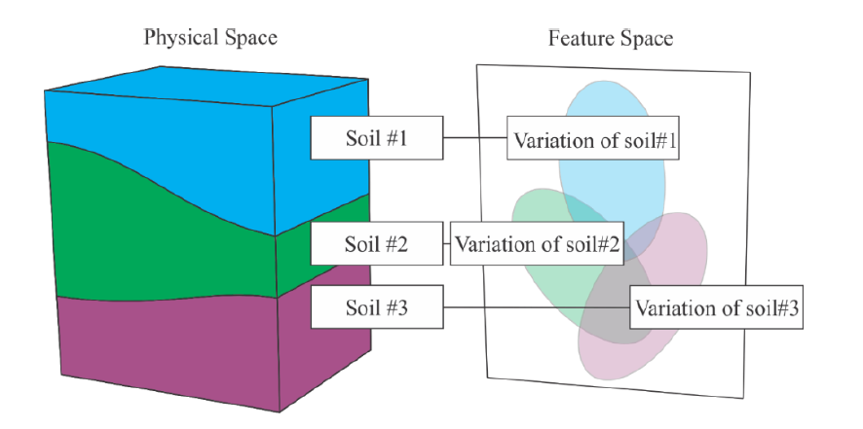
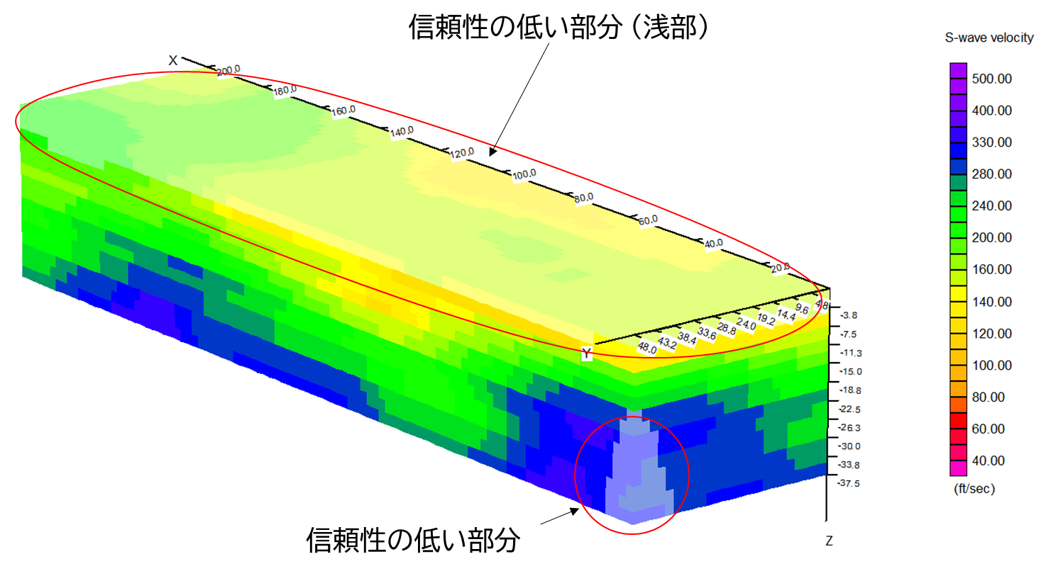
IfcTunnel – Geology & Geotechnics
Uncertainty in geological/geotechnical models
“Typology” of uncertainty
Two optional approaches:
Variability with time
Aleatoric uncertainty (variability)
Spatial variation
1. Definition of properties assigned to model objects
Individual difference, natural inhomogenities,…
Epistemic uncertainty (uncertainty due to lack of knowledge)
Input data / available ovservations
Decicions – Interpretation / geological concept
Modeling approach and methods
2. “Uncertainty Model”
3D Grid
Shear wave velocity and uncertainty
High uncertainty
© 2021 OYO
Wang et al. 2020

Slide 9
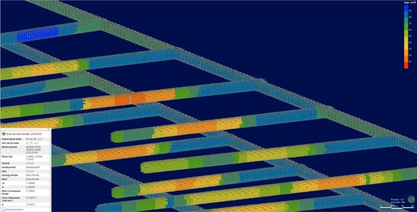
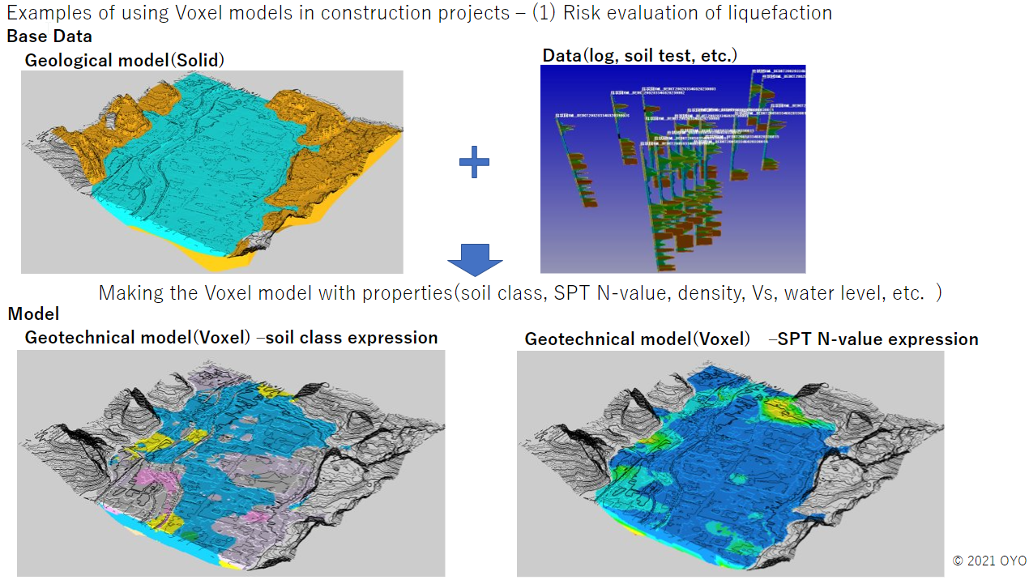
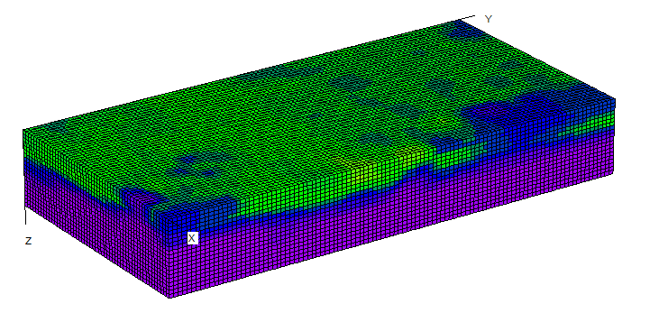
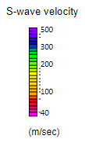
IfcTunnel – Geology & Geotechnics
Geometrical representations:
Requirement of voxel models / 3D grids
© Seequent,
2020
Exchanged information:
Results from geophysical surveys
Distribution of geotechnical parameters (geostatistical interpretations)
Stochastic methods
Uncertainty and reliability
Combinations of the above
RQD and Q estimates evaluated 3D Grid representing material properties in tunnel excavation space​
© OYO, 2020
Seismic velocities

Slide 10
IfcTunnel – Geology & Geotechnics
Geometrical representations:
Requirement of voxel models / 3D grids
Benefits and applications:
Combine and derive information from different disciplines on a simple common spatial framework (geophysics, geology, geotechnics, etc.)
Assessment (qualitative and quantitative) and management of risks
Full realization of uncertainty → reliability based design
Visualization in the common data environment (a more accurate abstraction of physical space)
Wang et al. 2020

